Slide 1
MedAlarm Requirements
Team 6 – Samantha Stone, Suyog Dahal, Caesar Nguyen, Justen Yergo

Slide 2
MedAlarm for the Provider
MedAlarm Application
Easily manage new software
Simplify UI of provider portal
Provider Use
Provider Story
Subtask 1
Ensure portal mimics EMR
Simple to get started and update
Subtask 2
Subtask 3
Notes:
The provider has three main uses for our software. The first requirement we are going create a solution for is to be able to easily manage their new software. We know the first step to using new software is logging in.

Slide 3
Serverless /API function: AWS Lambda
Restful API to ensure HIPAA security
Java
Database: AWS DynamoDB
Database that serves/stores data from the app
Java
Web portal: AWS Amplify
Client facing portal
JavaScript
Provider Login:
Software Specifications
Notes:
We are going to reduce capital expenditure by buying cloud services through AWS, so we don’t need to worry about purchasing servers or compiling software. We are using javascript to build the web portal through AWS Amplify and java for the restful APIs and database management using AWS Labmda and dynamodb.

Slide 4
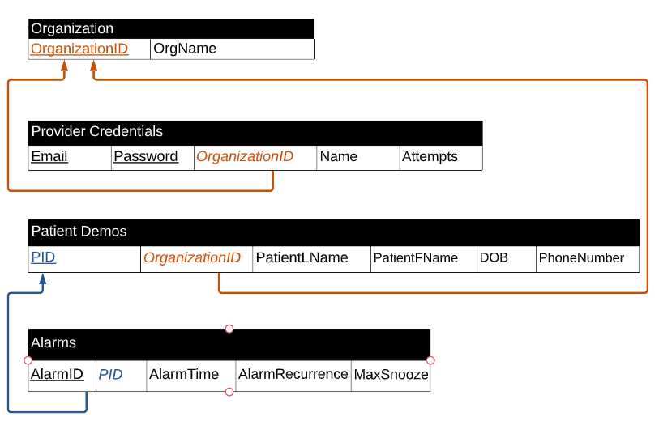
MAX = 5
Notes:
As mentioned previously in the backend, we will need to link credentials to the provider’s organization. That organization is linked to a patient database which will allow that user to query patient information and their alarms. The point to be made here is that information collected and used to log in is minimal. The user gets 5 attempts to login. Once those attempts are used the account is locked and not accessible until reset via a forgotten password reset link or AstraZeneca staff.

Slide 5
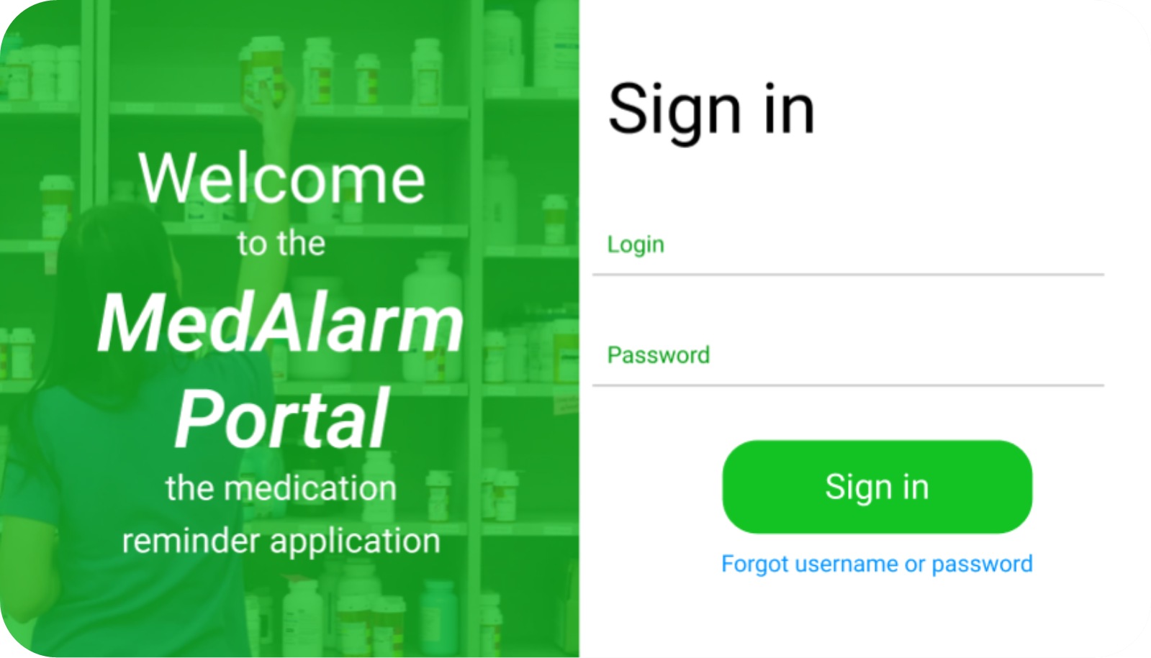
Requirement 1:
Email
Password
Sign-In
Max Wrong Attempts: 5
Successful login
New patient login
Forgot Password Link
Notes:
The provider login is where the experience begins. We want to ensure the login is as easy to navigate as possible so we will collect just the email and password to access the system. When the doctor registers to use MedAlarm we will collect the users name and email and we will link those credentials to the organization. The login page needs to have a space to enter their email address and their password and a successful sign in will route them to the alerts page – to be discussed at our next meeting. We also need to include a link for the staff to recover their account if they’ve forgotten their password. This link will direct you to verify your email address and the provider can reset their password from there- we will discuss that workflow at a later time.

Slide 6
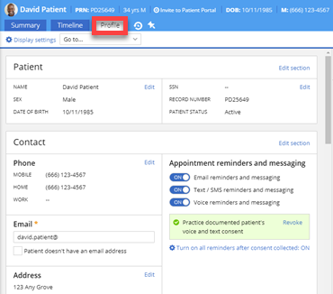
Notes:
We did some research and found out new patient registration pages in leading EHR systems across the nation all look the same and its about as boring as possible. To keep MedAlarm as easy to manage as possible we want to mimic the look and feel of systems that doctors are already using

Slide 7
Patient First and Last Name
Textboxes
DOB
Date textbox
PID – Organization ID + Sequentially generated number
Read only textbox
Generated by database- triggered by new patient page saved
Phone Number
Textbox
Enrollment status
Generated by database – triggered by patient signup
Alarms
Time – textbox
Max Snooze – Dropdown selection (Hours and minutes)
Days – Checkbox selection
Provider notifications – Dropdown (number of missed alarms)
Requirement 2:
New Patient Registration
Notes:
We want the easy to manage component to follow through the software. We have minimized the amount of information needed

Slide 8
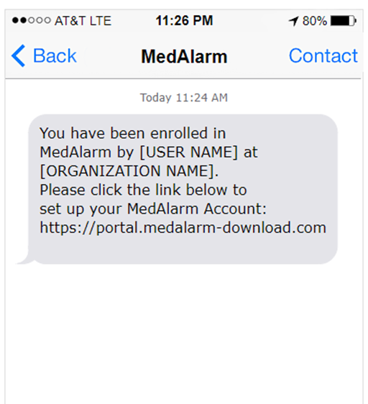
Requirement 3: Patient Enrollment Text
Database trigger
API AWS Lambda
Twillio text trigger
Text message sent
Patient enrollment
Notes:
Saving a patient for the first time or whenever the phone number is updated with trigger a text event. We will need to build an API between our web portal and twillio. We will need to write that API in Java. This will be an automated process. We will format the text message in a way that indicates which provider and staff member enrolled the patient.

Slide 9
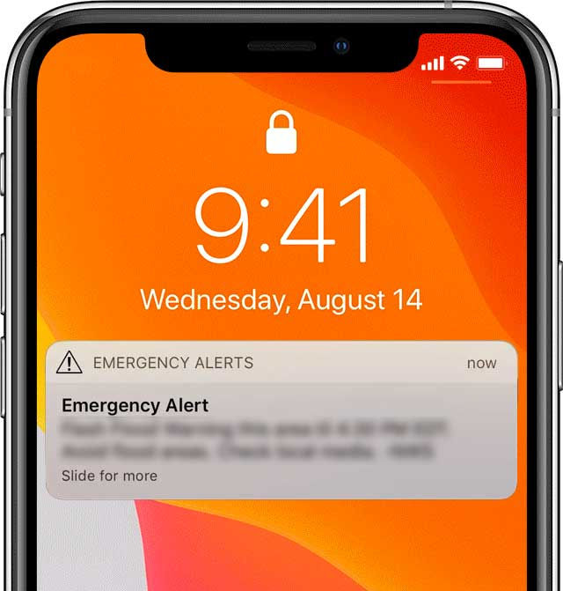
Requirement 4: Emergency Contact Notified
What Happens
- Emergency Contact is Notified.
- System will trigger automated response to caregiver/emergency contact when patient has over snoozed his medication or hasn't pressed his medication taken button.
- Notification will contain Patient's first initial, last name, and alert type as per the contacts settings.
Functional Requirements
- Missed Button Press On Patient App.
- If patient has missed their alarm a certain amount of times, the EC will be notified depending on their notification settings.
Notes:
Background: Patient will link Emergency Contact through their end of the app which sends an invite link for EC to join. EC information then is automatically added within Doctors Database. EC also has ability to choose after how many missed alarm button presses or snoozes they would like to be notified.
After Speaking with our stakeholder, our Patient's caregiver emphasized she wanted a notification that would be impossible to miss, so we will be notifying her using an amber alert type notification method that can alert her from a room away, or while her phone is not in the area. For this requirement to be triggered, The patient has to fully miss their alarm, and based on the EC settings however many times the patient misses their button press, then a notification will be sent.

Slide 10
Requirement 5: Providers Office Notified
What Happens When Patient Does not Take Medication/Press Button?
Our system will automatically keep track of when a patient presses a button, so when a button is not pressed it will know, and it will alert the Providers to prevent any life-threatening situations.
After a Patient has failed to take their medication 3 or more times the Doctor wants to be directly notified, otherwise the Providers office will handle it.
Functional Requirements
A missed alarm on the patient's application will trigger/increment the count.
Based on the count, our application will decide whether to send a notification just to the providers, directly to the doctor, or based on the provider's settings no action will be taken.
How Notifications will be sent.
Directly to Doctor or Provider's phone in case of emergency.
Work Email, Work Phone, Work Computer.
Notes:
Background: Doctor does not want to be notified if Patient has missed 1 medication, but once patient has missed an alarm 3 times or more, directly contact the doctor, else he wants notification to go to staff so they can update the patients information up to date for the next doctors report.
If doctor and providers believe that they do not need to be notified if a certain patient misses a medication once or twice they have the ability to change when they would like to be notified after a specific amount of missed button presses specific to the patient.

Slide 11
Review
Design:
Text: black, 12 point, Ariel Regular font
Accent color scheme: Forrest green and lime green
As simple as possible
HIPAA-compliant database set up through AWS Amplify, Lambda, and Dynamo DB
Use Java and JavaScript
1. Provider enrollment
Email & Password provided by AstraZeneca
Forgotten password link
Successful login routes to new patient setup page

Slide 12
Review continued
2. New patient set up
New patient demographics added by the provider
Patient Name, DOB, Phone number, and Alarms
PID is a concatenated string: [OrgID]-[SequentialNumber]
Sequential number restarts for each organization
Enrollment status: Date-time tied to user create date
3. Patient enrollment text message
Triggered by new patient save or phone number update
Automated by API with Twillio
Include:
Organization name
Name of user who enrolled patient
Link to the web app download

Slide 13
Review continued
4. Emergency Contact Notified
Triggered by MAX snooze being reached
Respects the settings of the emergency contact
Ring setting sounds like an emergency alert
Continuous ring until user opens the app and reads the alert
Alert states
Patient first initial
Patient last name
Alert trigger
5. Providers Office Notified
Tracking all button presses and snooze count downs
If snooze reached check provider frequency settings
Trigger notification when settings are met

